Slide 1

https://www.uni-goettingen.de/en/48115.html
UNPLAB-QuGen_Ch-1[Teaser] First Chapter on Quantitative Genetics
1

Slide 2
Sequential Number: #35
UNPLAB-QuGen_Ch-1[Teaser]
Unless I explicitly state otherwise, images and cartoons are created using ChatGPT.
You may use this material free of charge under the terms of the CC BY license. This requires that you provide appropriate attribution to the author: W. Link, University of Goettingen, Germany.
In a few cases, individual images, photographs, or similar material may be subject to a more restrictive Creative Commons license. Where this applies, it is explicitly indicated, and you must comply with the stated license terms for those items.
Please check the license information carefully before reuse. Responsibility for complying with the applicable license terms rests entirely with you.
This symbol usually indicates that a page is rather important
2

Slide 3
You already know:
Population Genetics
GxE and heritabililty and Breeders Equation
Breeding Methodology
Indirect Selection and Index Selection
Keywords of this chapter:
Question on ‚how to breed‘ and terms for answering and actual answers are sought via Quantitative Genetics.
This chapter is a teaser, advertising Quantitative Genetics
Algebra as introduced in this chapter: None
3

Slide 4
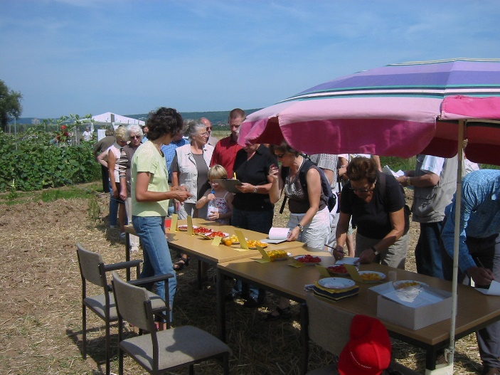
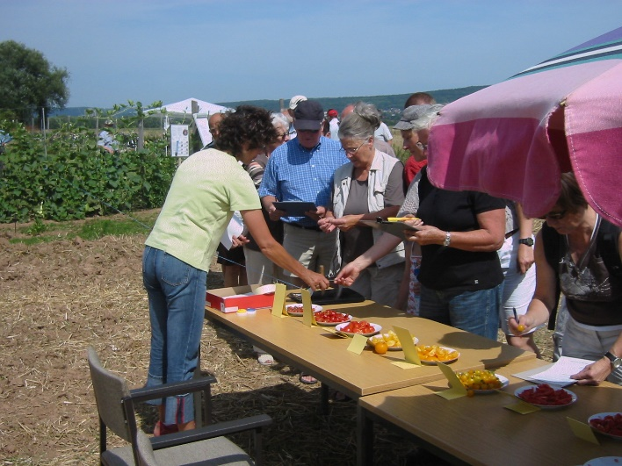
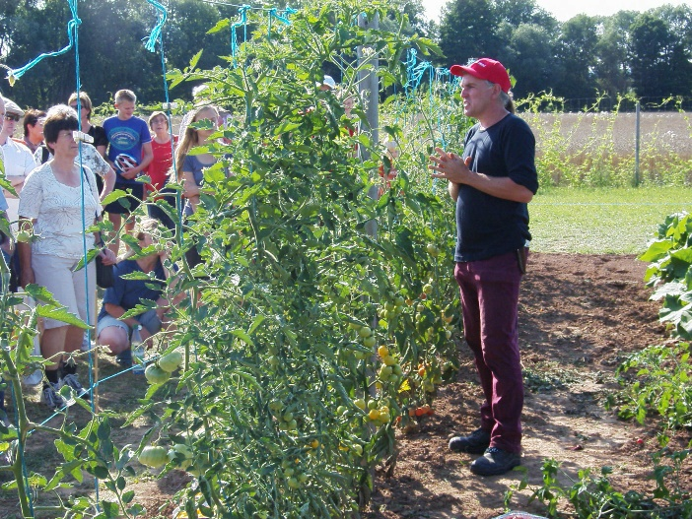
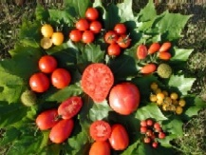
A teaser chapter to motivate studying Quantitative Genetics and Selection Theory (after having studied Population Genetics, GxE, Index, Plant Breeding Methodology).
© B. Horneburg, W. Link
In 2008, the organic tomato group at the Department of Crop Sciences (led by Bernd Horneburg) proudly presented the diversity of tomato types on the occasion of their 2008 Field Day.
I ask you: What is Plant Breeding?
If you grow and test a diversity of tomato types, is this Plant Breeding?
Is it necessary to cross different tomatoes in order to attach the label ‘Tomato Breeding’ to this activity?
Is it necessary to sell seed of a (set of) cultivar(s) to name your activity ‘Plant Breeding’?
4
Plant Breeding: You exploit a genetic Diversity by Selection; you propagate the selected ones to go on with them, as improved part of your germplasm.
https://s.gwdg.de/p9MaqK
Crossing is a frequent yet not necessary step to create genetic Diversity. You can breed without Crossing, fodder plant breeder sometimes ‚just‘ collect ‚ecotypes‘ to exploit Diversity. You can not breed without Selection.
Enjoying the diversity as tomato salad is not yet breeding. The Organic Tomato Group indeed conducted Breeding Research and Breeding: They selected and released outdoor tomato cultivars such as cv. ‘Vivarossa (B13)’.

Slide 5
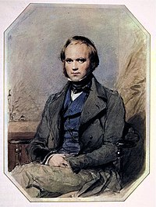
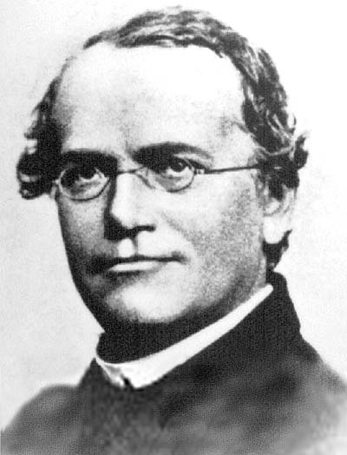
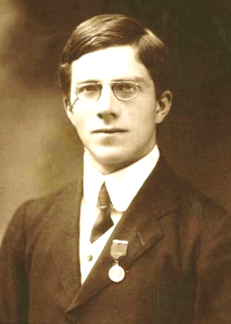
Charles Darwin, Gregor Mendel, Ronal Fisher. What is their contribution to Plant and Animal Breeding?
Darwin taught us that genetic diver-sity, in combination with the limi-tation of eco-niches’ resources, means that of the large number of offspring only those who happen to be relatively better adapted to the conditions-of-live will be parents for future generations; and that such better adaptation is inherited. Darwin did not know the biological source and path of such genetic diversity.
Mendel showed that there are here-ditary factors (‘genes’) that pass un-changed through the generations and are recombined afresh each time, and which can remain un-no-ticed due to recessive gene action. Mendel was only able to trace the genetics of qualitative characteris-ics such as colours and shapes.
Charles Darwin
1809-1882
Gregor Mendel
1822-1884
Sir Ronald Fisher (1890-1962)
https://en.wikipedia.org/wiki/Charles_Darwin
https://de.wikipedia.org/wiki/Gregor_Mendel
https://en.wikipedia.org/wiki/Ronald_Fisher
5

Slide 6
Charles Darwin, Gregor Mendel, Ronal Fisher. Their fin-dings are the foundation of Applied Genetics & Breeding.
6
Although Darwin plus Mendel explain much of the making and change and evolution and exploita-tion of genetic diversity, they could not explain the inheritance of quanti-tative traits, such as number of off-spring (litter size; grain yield).
Ronal Fischer used statistics to overcome the gap. The clue was his assumption that a very high number of ‘Mendelian’ factors jointly control and inherit the genetic (and pheno-typic) variation. These factors (‘genes’) each contribute very little (Infinitesimal Model); their small effects are in addition impacted by environment. This concept made the foundation of Modern Breeding and Quantitative Genetics.
Watson-Crick’s (1953) discovery of DNA was firstly important for Genetics.
Charles Darwin
1809-1882
Gregor Mendel
1822-1884
Sir Ronald Fisher (1890-1962)
https://en.wikipedia.org/wiki/Charles_Darwin
https://de.wikipedia.org/wiki/Gregor_Mendel
https://en.wikipedia.org/wiki/Ronald_Fisher
Mayr, E., 1982: The growth of biological thought. Cambridge, Massachusetts.
ISBN 0-674-36445-7

Slide 7
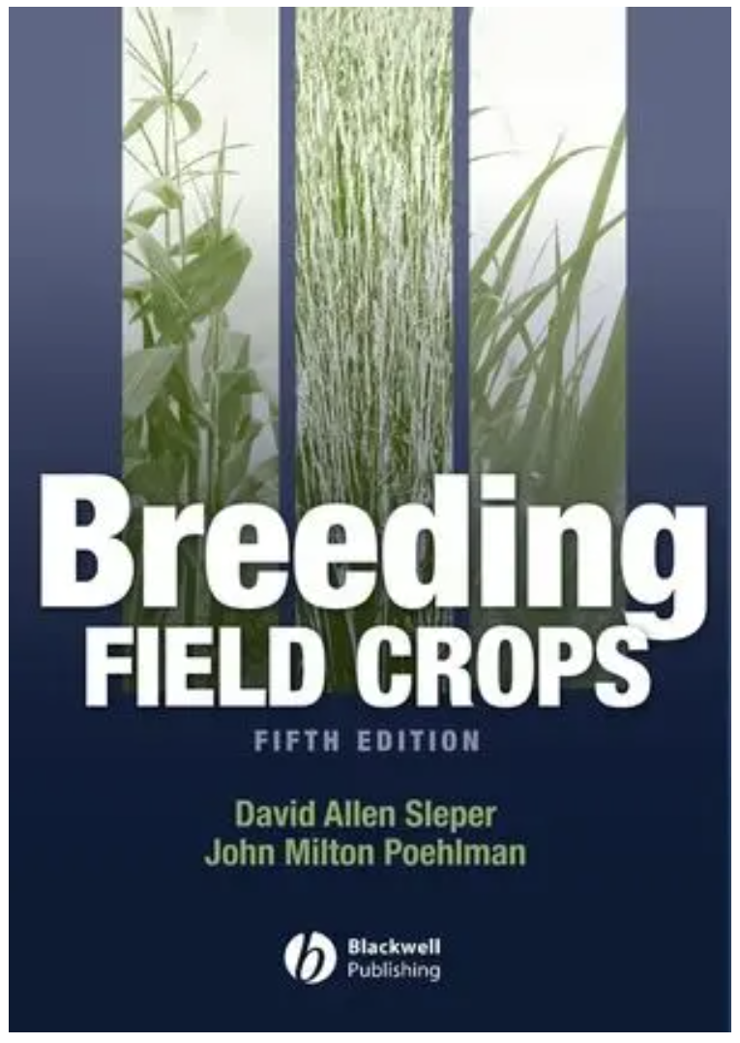
Plant Breeding may be presented as two parts: (1) Plant Breeding Methodology and
(2) Specific Plant Breeding (ISBN: 978-0-813-82428-4).
Sleper and Poehlman (2006), as an example, started the topic with Plant Breeding Methodology, focussing on topics such as:
What is Plant Breeding?  The Genetic Basis of Plant Breeding  Repro-duction in Crop Plants  Quantitative Inheritance in Plant Breeding ...
⬧ Methods in Plant Breeding  Breeding Self-Pollinated Crops  Breeding Cross-Pollinated Crops  Breeding Clonally Propagated Crops  Breeding Hybrid Cultivars  ...
They then continued with Specific Plant Breeding, i.e. explaining species-specific breeding features, peculiarities, objectives, constraints.
They chose wheat, rice and soybean to present the category of
♪ Line Breeding (self-fertilizing crops).
They chose maize and sorghum to present the category of
♪ Hybrid Breeding (partly or fully outcrossing crops).
They presented forage crops as examples for
♪ Population Breeding (outcrossing crops).
They chose potato and sugar cane as example for
♪ Clone Breeding (vegetatively propagated crops).
7

Slide 8
Plant Breeding in a more general sense may be split in
Pre-Breeding (Pilot-Breeding, Recurrent Selection) and
Cultivar Development (i.e., Plant Breeding in narrow sense).
(1)
The diagram here is a scheme (protocol, method, sketch) to show the step by step flow of a so-called ‚Combined Fullsib and S1-line Recurrent Selection for Sorghum (http://oar.icrisat.org/10036/1/Population%20Improvement.pdf).
It starts (1) with a genetically diverse germplasm (Basic Population). Phenotypi-cally ‚good‘ plants ● are crossed (as pairs), thus, bi-parental families are created. In step (2), these are field-tested in plots for their agronomic performance. In pa-rallel, few individuals per family are (not tested but) self-fertilized (prevent out-crossing) to produce seed of so-called S1-lines. After harvest, the promising families are identified. As (3), S1-lines of these promising families are field-tested, again selection is conducted. Remnant seed of the selected S1-lines (that has been stored instead of sown) is used to recombine (inter-cross) these ‚best‘ S1-lines (4), thus, recreating a still diverse yet improved Basic Population.
Step (1’) looks like (1): The next Cycle of this Recurrent Selection Scheme.
(2)
UNPLAB-BrMeth_Ch-7[RecSel III], page 5 ff
(3)
(4)
Recom
-bine
Cultivar
Each cycle‘s outcome can in addition be proposed as new candidate cultivar (population cultivar) – hence, Recurrent Selection may overlap with Cultivar Development.
(1‘)
8

Slide 9
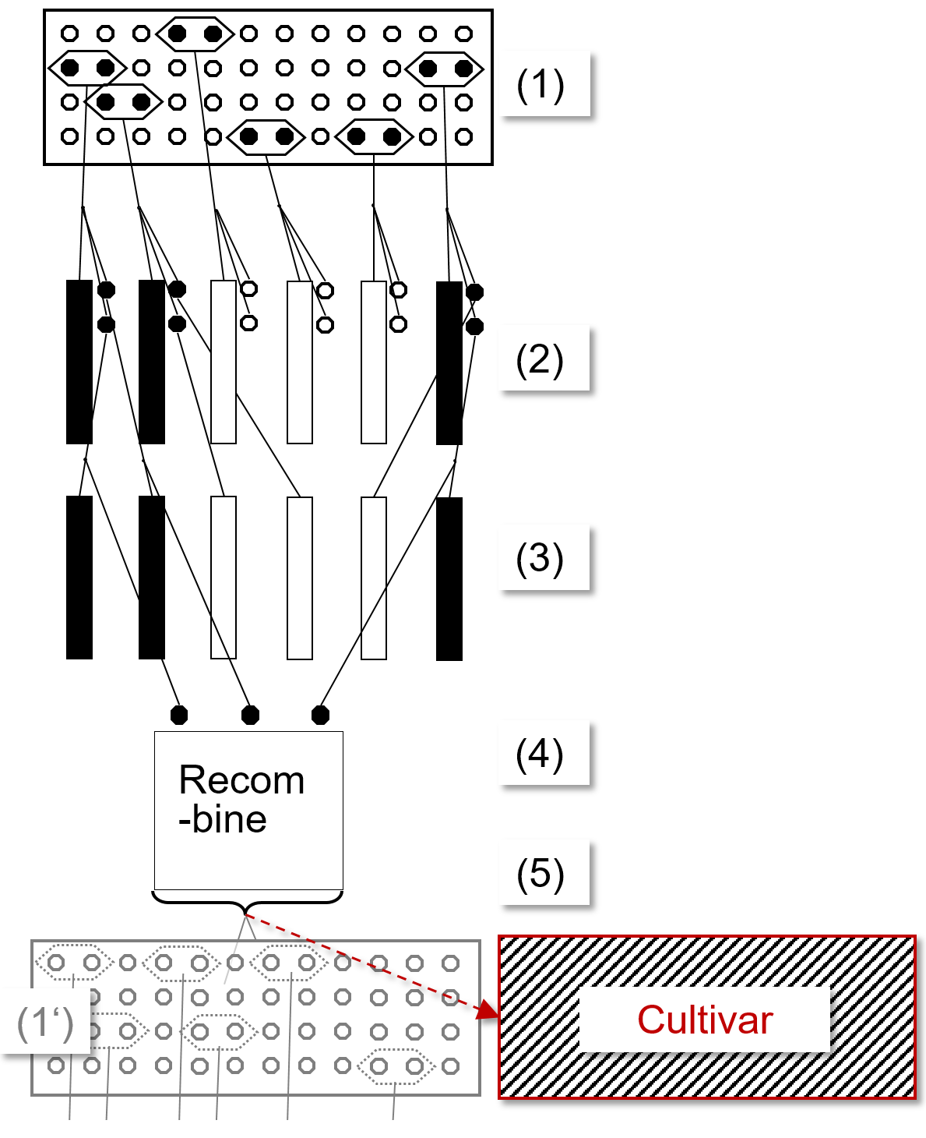
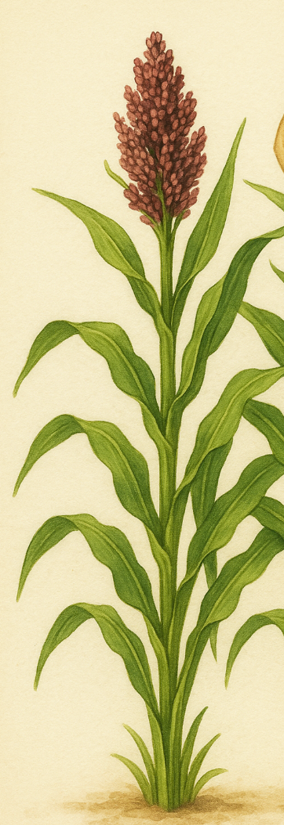
Questions, thoughts, on the occasion of this scheme.
9
When phenotypically selecting among these crossing-pairs, we are kind of handicapped compared to a selection between individual plants. We know from general statistics that the variance between means-of-two is only half the variance between individuals (best plants will not necessarily grow adjacent = be crossed with other good plants).
So, why crossing superior individuals pairwise instead of selecting the best individuals (without compromise)?
Selecting individuals means either that their offspring is (selfed and) crossed more or less at random (uncontrolled) with the surrounding fathers or that we actually self-fertilize them (controlled, via paper-bagging).
If we allow random fathers, then our single-plant offspring are to some extent similar to each other, since they share more or less the same fathers – this reduces variance between them, where we wanted to have it large. If we self-fertilize, then the full diversity between the plants stays as full diversity between their S1-lines. Really? The plants of the Basic Popu-lation are not or little inbred, yet, the S1-lines are markedly inbred; will this influence the variance between them? Will the selection out-come be adequate even if the ultimate cvs. will be non-inbred?
Answers to such question can come from Quantitative Genetics; at least Quantitative Genetics has the terms to properly discuss theses topics.
Sorghum

Slide 10
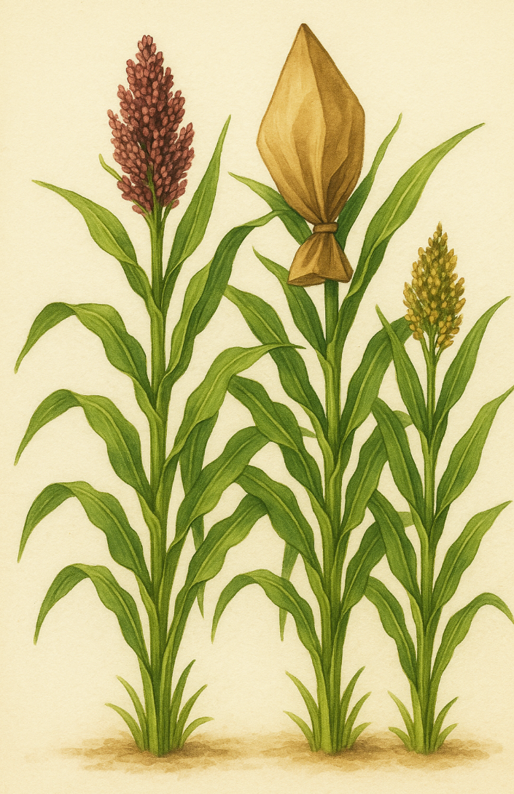
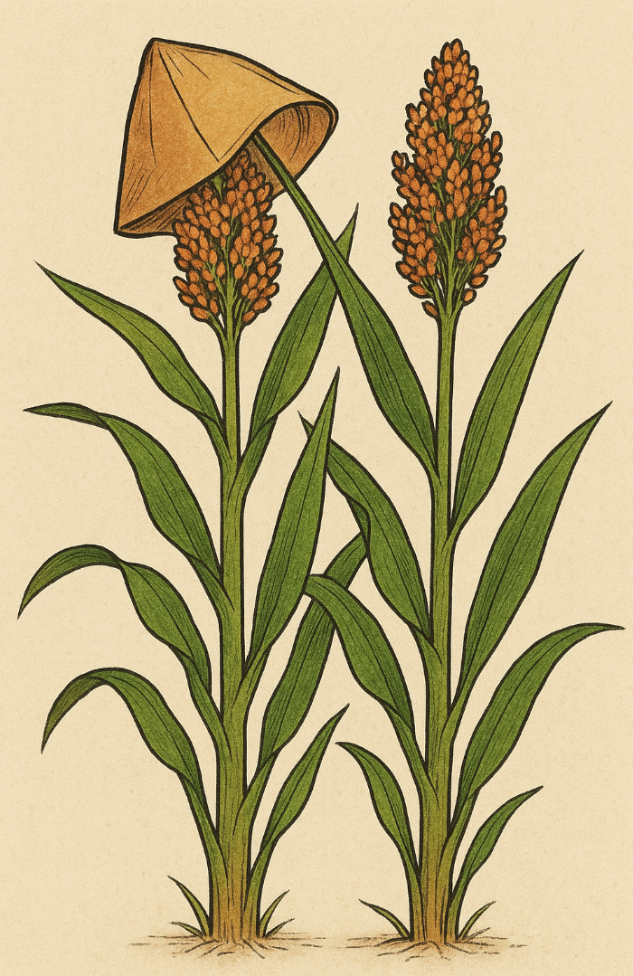
Questions, thoughts, on the occasion of this scheme.
10
When self-fertilizing few individuals in (2), the purpose is to have seed for field-testing S1-line in (3) such that such seed is not contaminated by outcrossing in (2) (with unknown fathers) and that the S1-lines well represent the family to which their ancestral individual in (2) belonged. How well will few individuals represent their family?
So: How many individuals are needed for an adequate representation? If they are self-fertilized and selfed seed is used for the recombination step (4), does this impact the outcome - compared to directly intercross the individuals as they exist in (2)? And ... Is it necessary to cross each with each – which is demanding – or can we recombine ‘cheaper’?
When having the data from field season (3), should we or must we join these results with the results of the previous season (from those families the S1-lines of which were tested in (3) - or from all families)? Mind you, it may be demanding to scrupulously assess the exactly same traits in the same way in (2) and (3) so as to make the date fully compatible.
Cf. UNPLAB-h²_GxE_Ch5[BredersEquation] page 12 ff.
If in (1’) we use the next generation‘s Basic Population to create a cultivar, crossed seed from how many of the individuals that were used in the intercrossing (recombination) step (4) should be used? Should there be selection between these individuals? What is the expected change of genetic variance from cycle to cycle due to the selection that we impose?
Some hints were included in UNPLAB so far, further ones will come now.
(2)

Slide 11
Allocation of materials, money, labour to the different steps of this scheme
These figures are the result of an Optimization of Allocation within this scheme (Schipprack, 1993):
N₁=280; N₂=45; N₃=5; N₄=35.
Overall budget is restricted. A higher number of initial crossing pairs is desirable, yet, the consequence would be a lowering of the other numbers.
More than 45 families (fullsibs) would be desirable, to reduce genetic Drift, yet …
less than 45 families (fullsibs) would be desirable, to select harder, yet this would increase Genetic Drift.
More than N₃=5 would be desirable to better represent the corresponding family and to have more S1-lines to select from per family (per pair-cross), yet ...
More than N₄=35 S1-lines would be desirable, to reduce genetic Drift, yet …
Less 35 S1-lines would be desirable, to select harder, yet this would increase Genetic Drift.
Base population: Cross N₁
pairs of individuals.
Evaluate N₁ fullsibs at 2 locs., select N₂ best; produce N₃ S₁-lines per fullsib (selfing).
Evaluate N₂∙N₃ S₁-lines, select N₄ best.
Use remnant seed to
diallel cross N₄ best S₁-lines.
Recom-bine
We did for instance not yet ponder whether the selected 35 S1-lines should be selected evenly across the families to which they belonged – to reduce Genetic Drift and Inbreeding; or whether we should select them independent from that point of view. Maybe we should select more from the very best families than from the just good-enough families ... ?
11
11

Slide 12
From here you may go to UNPLAB-QuGen_Ch-2[Transition I]
ChatGPT does not get the point of ‚bagging‘. And despite patiently explaining and even showing it, it didn't understand what it looks like when you put the inflorescences of two individuals together under a common bag (for crossing). Well, this was in May 2025. OpenAI 2025. Sorghum plant sketch. AI-generated sketch, from ChatGPT: GPT-4 with DALL·E. https://chat.openai.com.
12
12

